Slide 1
P1666.1
SystemC Analog/Mixed-Signal (AMS) extensions
Working Group
March 9, 2015 | Martin Barnasconi | P1666.1 Chair

Slide 2
Call to order &
Roll CAll
Current roster:
Sumit Adhikari, NXP Semiconductors
Martin Barnasconi, NXP Semiconductors
Dennis Brophy, Mentor Graphics
Fabio Cenni, STMicroelectronics
Joe Daniels, Accellera representative
Karsten Einwich, Fraunhofer IIS/EAS
Paul Floyd, Atrenta Inc.
Olivier Guillaume, STMicroelectronics
Mladen Nizic, Cadence Design Systems
Gerhard Noessing, Lantiq
Resigned
Kevin Cameron (Synopsys Inc.)

Slide 3
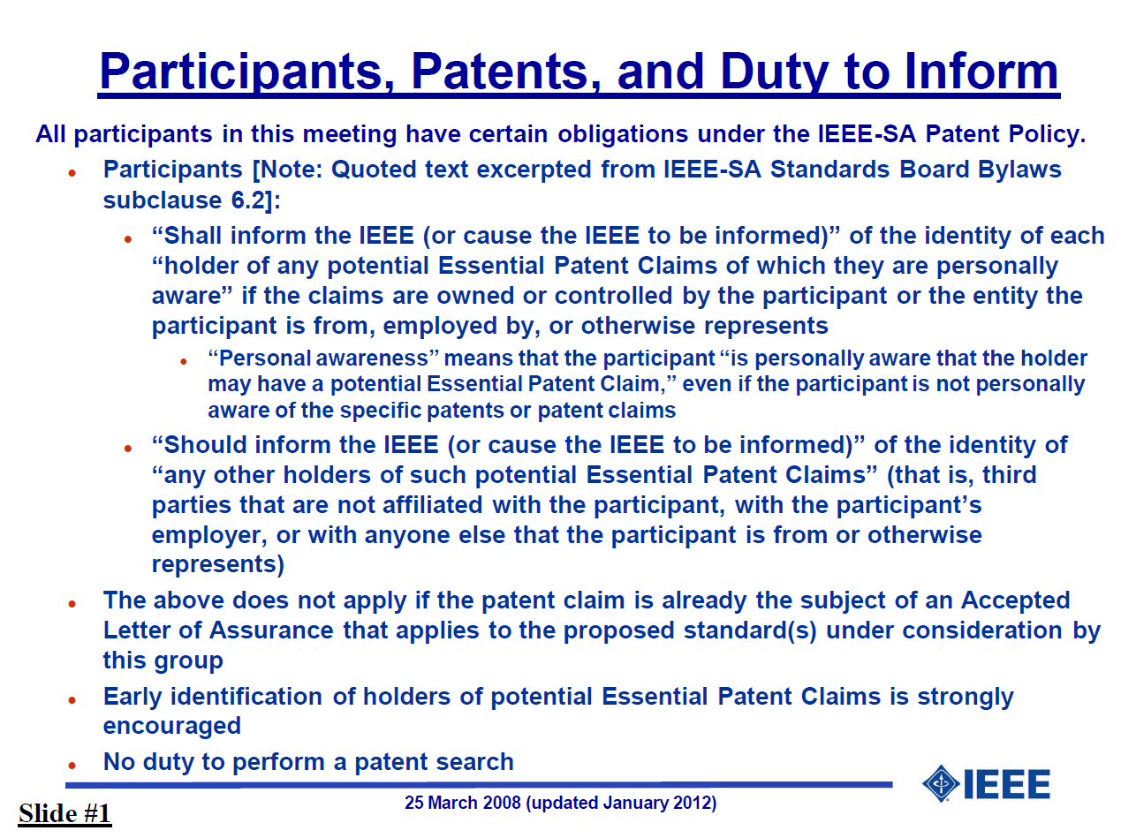
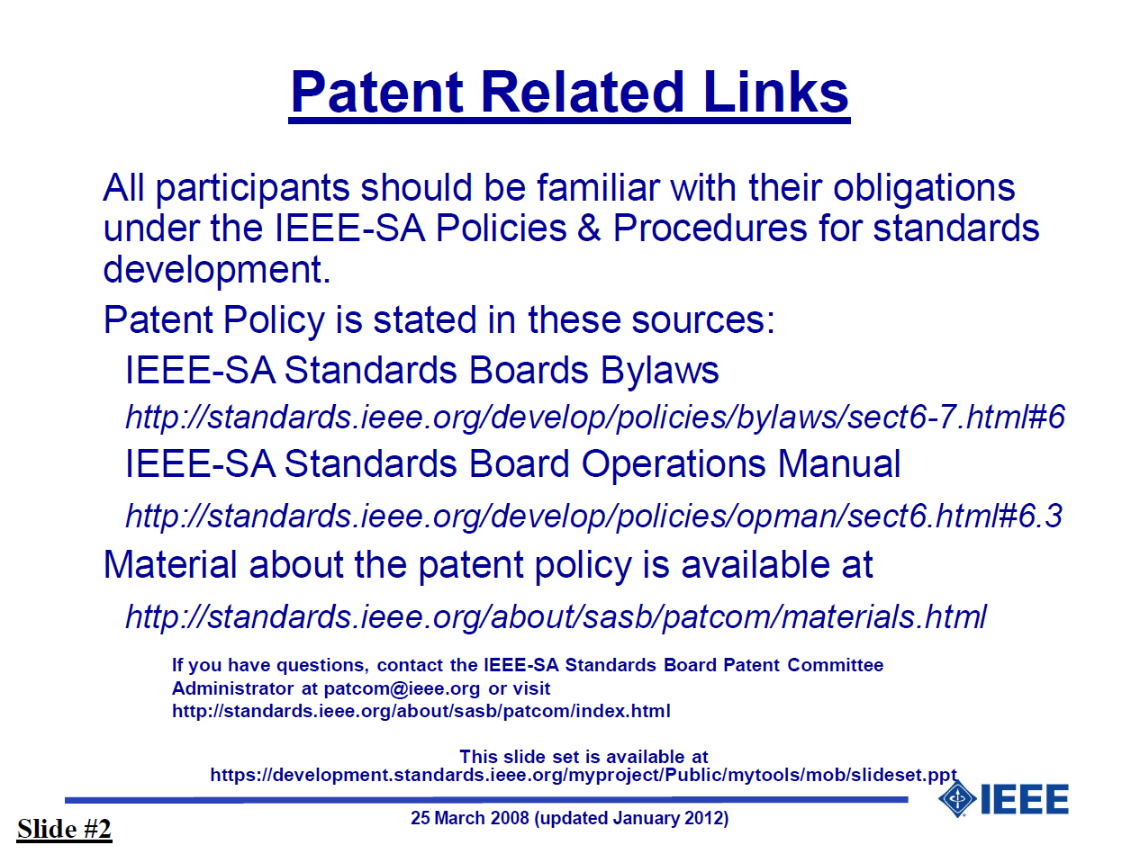
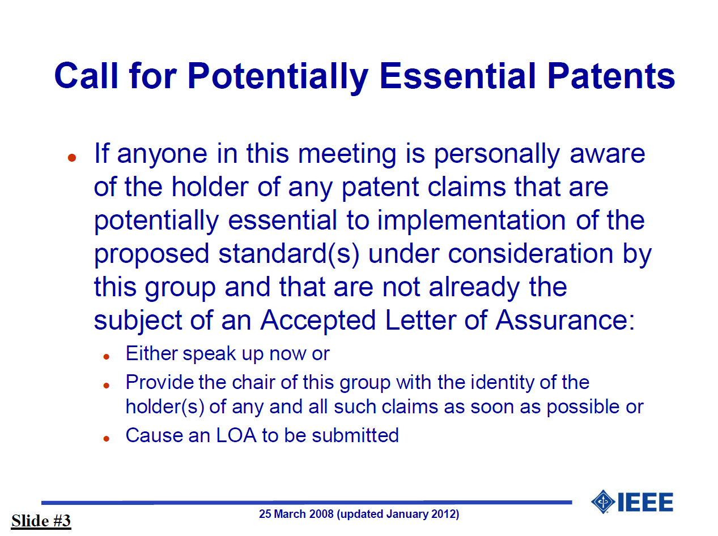
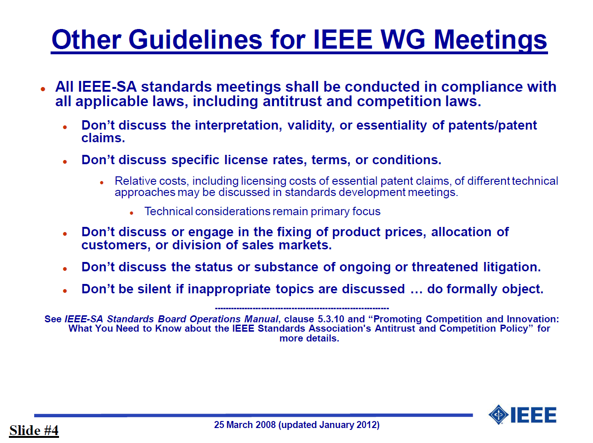
IEEE-SA patent policy and call for patents
IEEE patent policy:
http://standards.ieee.org/board/pat/pat-slideset.pdf
Call for Potentially Essential Patents

Slide 4
Approval of the Agenda
Call to order
Roll call
IEEE-SA patent policy and call for patents
Approval of agenda
Approval of previous meeting minutes of January 5,2015
Officer announcements
SystemC AMS change requests
SystemC AMS LRM technical documentation update
AOB
Next meeting: April 13, 2015 at 17:00h CET
Adjournment
Make a motion to approve the agenda

Slide 5
Approval of previous meeting minutes
Meeting minutes of January 5,2015
Make a motion to approve the minutes

Slide 6
Officer Announcements
In line with the IEEE-SA policies and procedures, the sponsor committee (DASC) affirmed the election of the officers:
  Martin Barnasconi as Chair
  Karsten Einwich as Secretary
Congratulations!

Slide 7
SystemC AMS change requests
No new change requests received during the last month
Latest version of the document (v3) available in Twiki member area
Overview of considered change requests
  CR980: Initial value of vector
  CR1006/1061: remove hierarchical decoupling port
  CR1036: Add sc_in/sc_out constructors
  CR1046: rename phi0 -> psi0
  CR1062: Semantics of delay changes
  CR1063: sca_module argument should be const-ref
  CR1067: Initial value of CT port at t=0
  CR1070: Remove const-ness for argument for assignment operator= converter and decoupling output ports
  CR1071: Define access function for ac and ac-noise simulation for the decoupling ports sca_out<T,SCA_CT/DT_CUT>
  CR1072: Make read methods of converter ports and trace variable object consistent (non-const)

Slide 8
SystemC AMS technical documentation UPDATE
Current status of DITA based documentation flow
  Publishing flow based on DITA XML and Open Toolkit version 1.8.5 running
  Created DITA style sheet for PDF document creation, compatible with IEEE-SA Standards Style manual
    Some inconsistencies in IEEE-SA Standards Style manual found
    Customization of cross-references resolved
  MathML formulas supported
  Syntax/code highlighting supported
Some LRM chapters from Docbook XML transformed into DITA XML
  Examples given on the next page
Target to have entire Accellera SystemC AMS 2.0 LRM transformed end of March

Slide 9
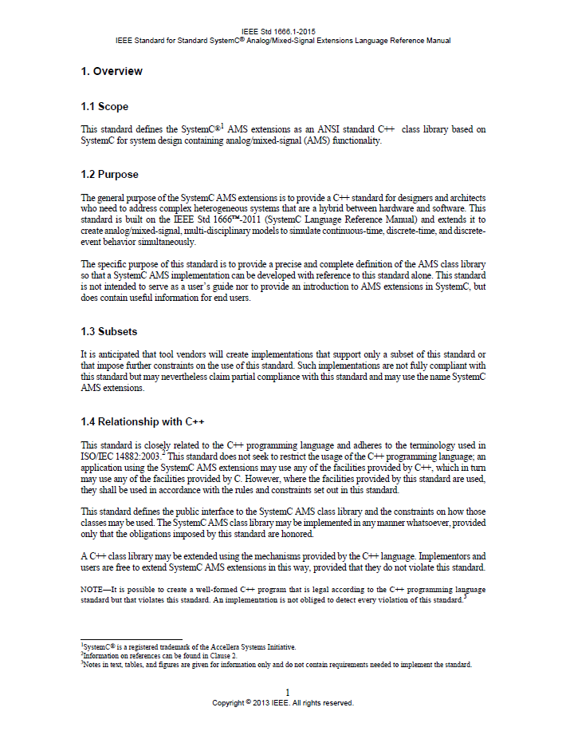
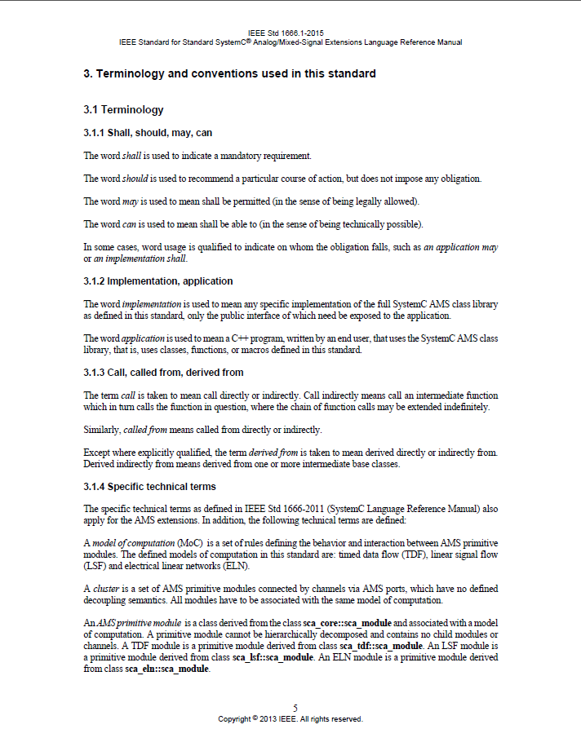
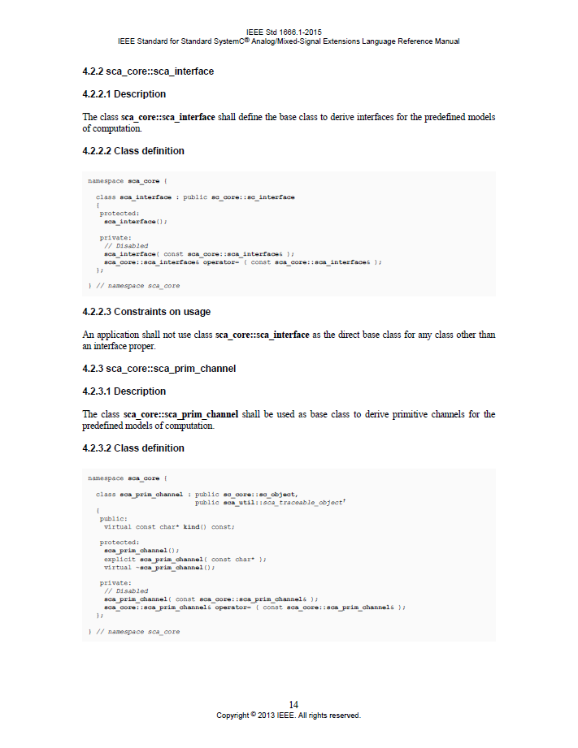
SystemC AMS technical documentation ExampleS

Slide 10
SystemC AMS technical documentation process
Timing (same as reported in December 2014):
Q1-2015:
  Identify inconsistencies, incorrectness, incompleteness in existing LRM
Q2-2015:
  LRM update, first IEEE draft of P1666.1 available
  Start WG review

Slide 11
Any other business
P1666.1 Operations manual – update foreseen
  Informal document, including more details and clarity on membership types, required attendance, voting rules, etc.
Attendance tracking page on Twiki:
  http://www.eda.org/twiki/bin/view.cgi/P16661/AttendanceTracking
  Please let me know if your company attendance is not tracked correctly
AOB of the attendees

Slide 12
Next meeting & Adjournment
April 13, 2015
5:00pm CET
Draft agenda:
http://www.eda.org/twiki/bin/view.cgi/P16661/April13%2c2015
Please let me know if you have additional items for the agenda
Make a motion to adjourn
the meeting
(no second)

