Slide 1
P1666.1
SystemC Analog/Mixed-Signal (AMS) extensions Working Group
June 1, 2015 | Martin Barnasconi | P1666.1 Chair

Slide 2
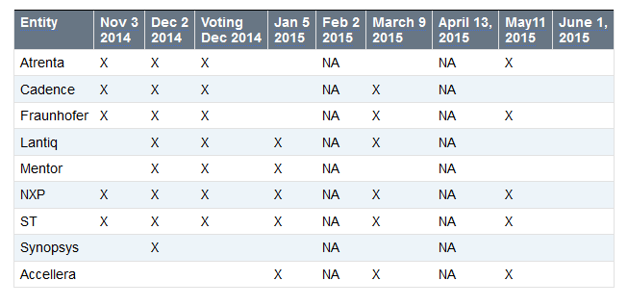
Call to order & Roll CAll
Attendance tracking to date:
Voting rights today:
NXP
Fraunhofer
Accellera

Slide 3
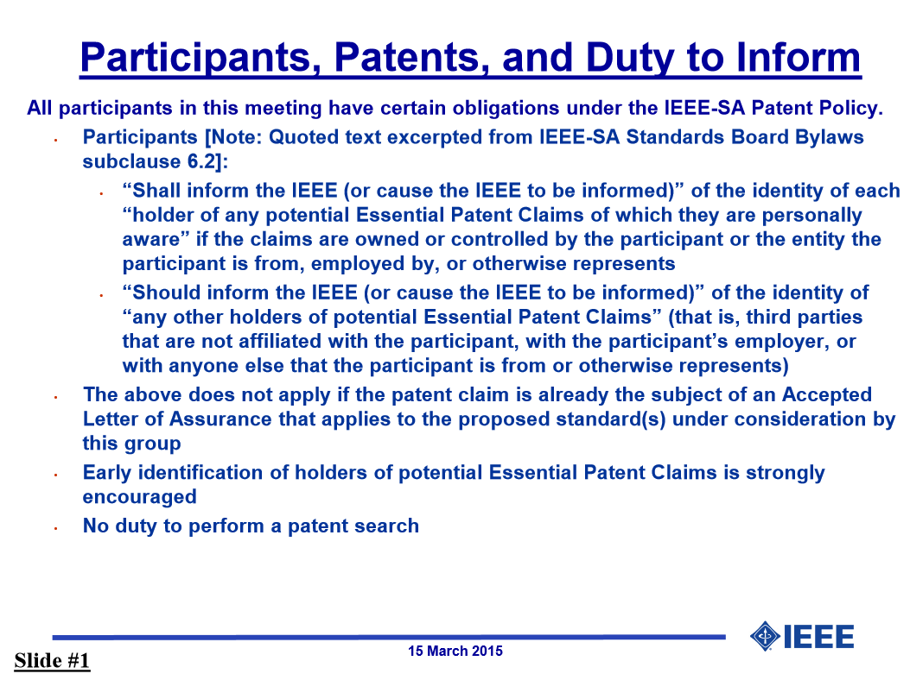
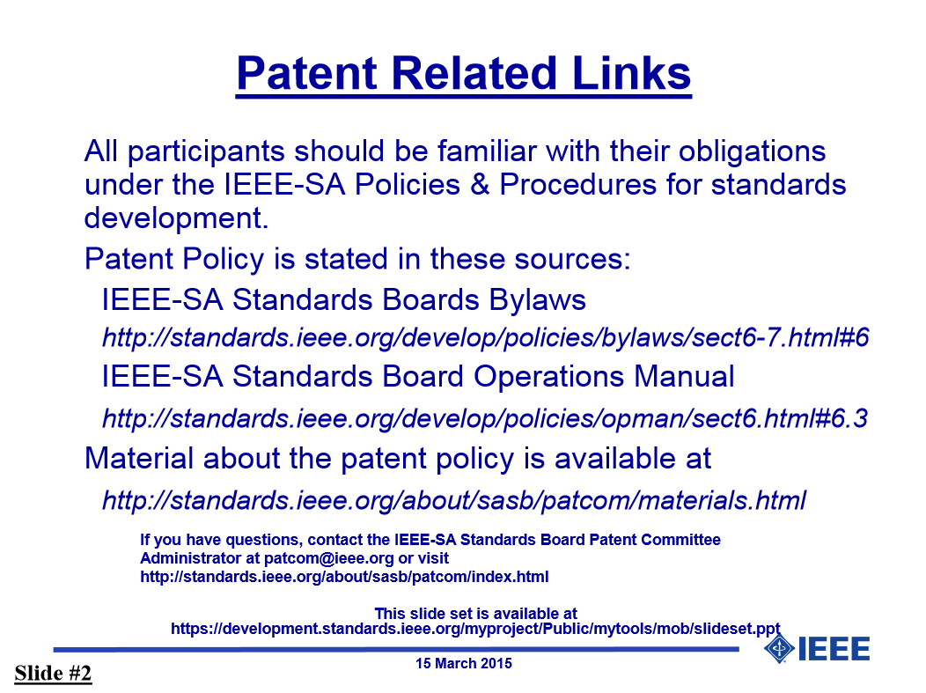
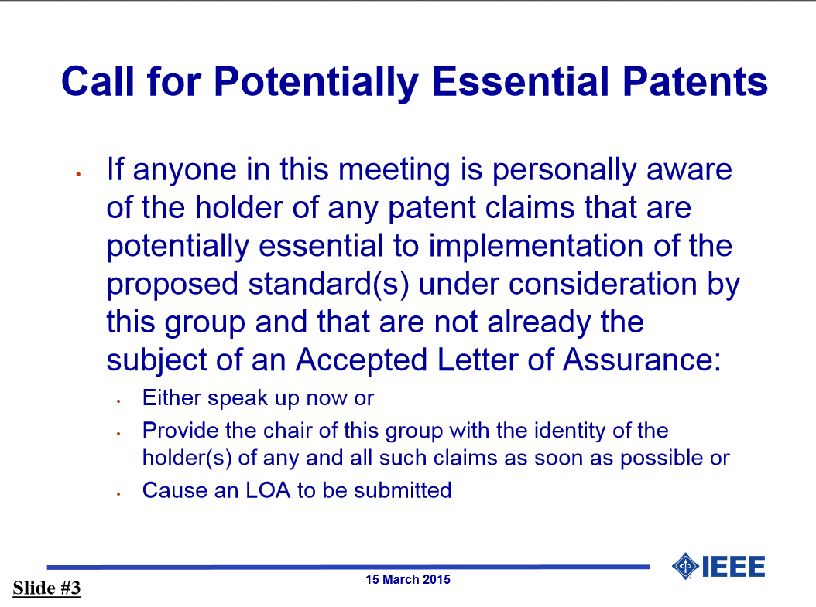
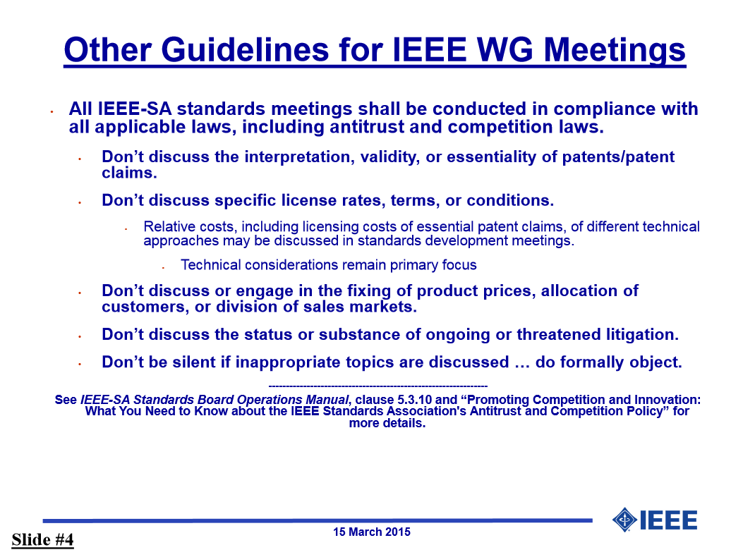
IEEE-SA patent policy and call for patents
IEEE patent policy:
Presentation can be found here: http://standards.ieee.org/board/pat/pat-slideset.pdf
Call for Potentially Essential Patents

Slide 4
Approval of the Agenda
Call to order
Roll call
IEEE-SA patent policy and call for patents
Approval of agenda
Approval of previous meeting minutes of May 11, 2015
SystemC AMS LRM technical documentation update
AOB
Next meeting: July 6, 2015 at 17:00h CET
Adjournment
Make a motion to approve the agenda

Slide 5
Approval of previous meeting minutes
Meeting meeting minutes of May 11, 2015
Make a motion to approve the minutes

Slide 6
technical documentation UPDATE
Draft 2 available of P1666.1 SystemC AMS LRM
Content update
CR980 added
CR1062 added
IEEE stylesheet improvements
Title page, IEEE notices, header/footers, Index, etc.
Still some items TODO
Draft 2 available in private space on Twiki: http://www.eda.org/twiki/pub/P16661/MemberArea/P1666.1_D2_June_1_2015.pdf

Slide 7
technical documentation UPDATE - change request IMPLEMENTATION
CR980: Initial value of vector – DONE – Please review
CR1006/1061: remove hierarchical decoupling port – DONE – Please review
CR1036: Add sc_in/sc_out constructors – DONE – Please review
CR1046: rename phi0 -> psi0 – DONE – Please review
CR1053/1054/1055/1056/1059: remove argument names when not used in text– DONE – Please review
CR1060: add ac_processing to text – DONE – Please review
CR1062: Semantics of delay changes – DONE – Please review
CR1063: sca_module argument should be const-ref – DONE – Please review
CR1067: Initial value of CT port at t=0 – DONE – Please review
CR1070: Remove const-ness for argument for assignment operator= converter and decoupling output ports – DONE – Please review
CR1071: Define access function for ac and ac-noise simulation for the decoupling ports sca_out<T,SCA_CT/DT_CUT> – DONE – Please review
CR1072: Make read methods of converter ports and trace variable object consistent (non-const) TODO: NEEDS DISCUSSION/INPUT
Updated document: http://www.eda.org/twiki/pub/P16661/MemberArea/change_requests_scams_for_ieee_1666_1_v5.pdf

Slide 8
technical documentation UPDATE – REVIEW TIMELINE
Anticipated timeline for P1666.1 LRM
May 11, 2015: First draft available; review can start
June 1, 2015: Second draft planned; 2nd round review;
July 6, 2015: All change requests implemented, finalize IEEE typographical updates; Freeze technical content/update; final WG review;
August 2015: P1666.1 working group ballot to ratify the standard
Sept/Oct 2015: Transfer document to IEEE for formal balloting process

Slide 9
Any other business
Attendance tracking page on Twiki:
http://www.eda.org/twiki/bin/view.cgi/P16661/AttendanceTracking
Please let me know if your company attendance is not tracked correctly
AOB of the attendees

Slide 10
Next meeting & Adjournment
July 6, 2015
5:00pm CET
Draft agenda:
http://www.eda.org/twiki/bin/view.cgi/P16661/July6,2015
Please let me know if you have additional items for the agenda
Make a motion to adjourn the meeting (no second)

