Slide 1
P1666.1
SystemC Analog/Mixed-Signal (AMS) extensions Working Group
July 6, 2015 | Martin Barnasconi | P1666.1 Chair

Slide 2
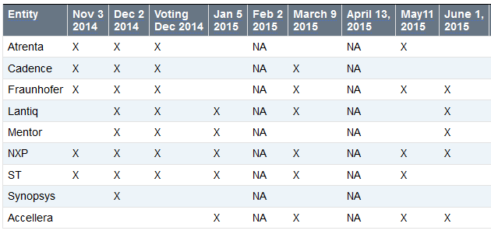
Call to order & Roll CAll
Attendance tracking to date:
Voting rights today (at start of meeting):
NXP – present today
Fraunhofer – present today
Accellera – present today
ST – present today
Lantiq – present today
* Entities with voting rights should have attended two of the last three meetings.

Slide 3
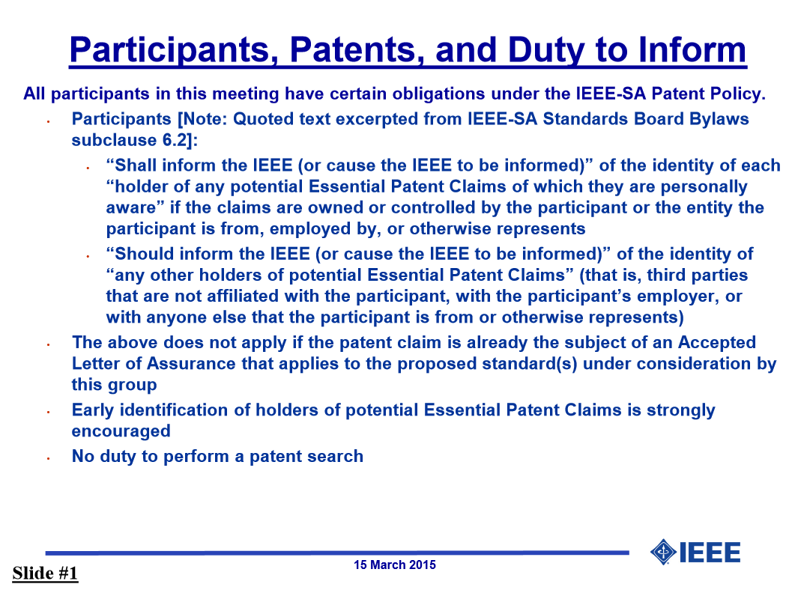
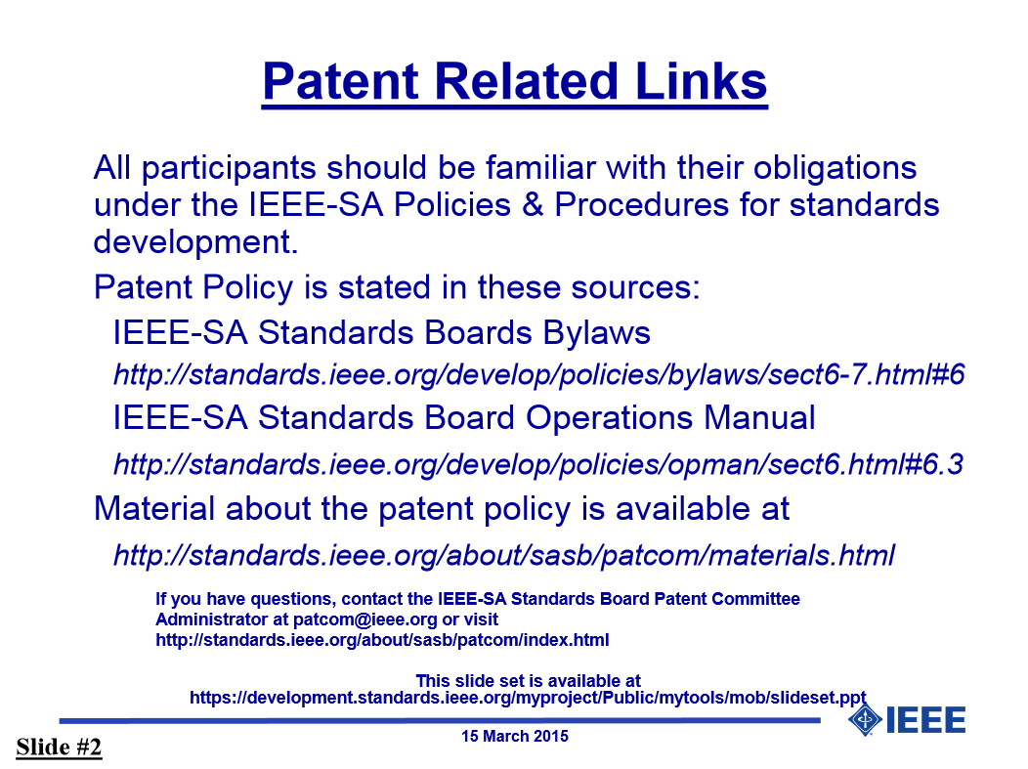
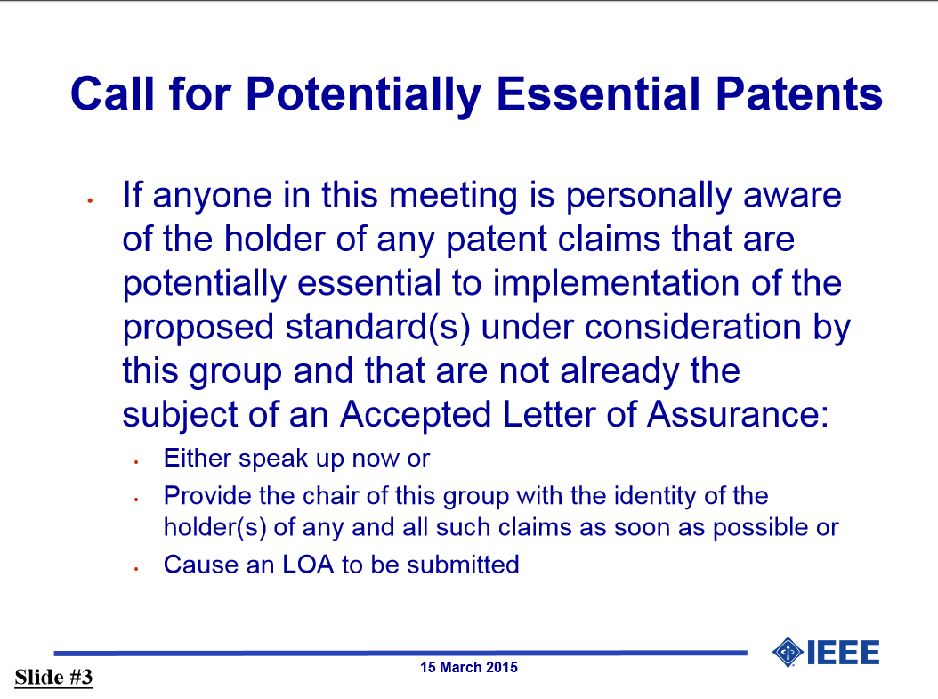
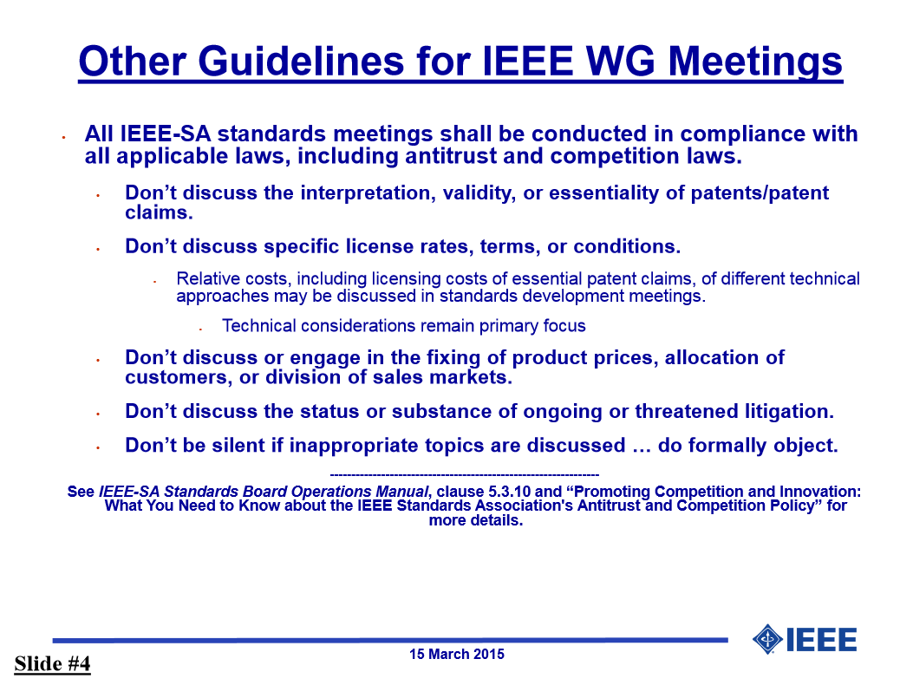
IEEE-SA patent policy and call for patents
IEEE patent policy:
Presentation can be found here: http://standards.ieee.org/board/pat/pat-slideset.pdf
Call for Potentially Essential Patents

Slide 4
Approval of the Agenda
Call to order
Roll call
IEEE-SA patent policy and call for patents
Approval of agenda
Approval of previous meeting minutes of June 1, 2015
Temporary appointment Secretary officer
SystemC AMS LRM technical documentation update
IEEE review and balloting process
AOB
Next meeting: September 7, 2015 at 17:00h CET
Adjournment
Make a motion to approve the agenda

Slide 5
Approval of previous meeting minutes
Meeting meeting minutes of June 1, 2015
Make a motion to approve the minutes

Slide 6
Temporary appointment Secretary OFFICER
The secretary officer position became vacant
In accordance with the P1666.1 P&P Clause 3.2, the Chair can make a temporary appointment for a period of up to 12 months
Thilo Vörtler becomes the new DR of Fraunhofer and is appointed by the chair as Secretary officer on temporary basis
The election and appointment for the vacated secretary office will be made at the earliest practical time, in accordance with the procedure as defined in the P&P Clause 3.1.

Slide 7
technical documentation UPDATE (1)
Draft 3 available of P1666.1 SystemC AMS LRM
Content update
CR1072 (read methods of converter ports non-const) implemented
CR1073 (macro IEEE_16661_SYSTEMC_AMS) implemented
CR1074 (More explicit definition of using sc_main and sc_start) implemented
CR1075 (Move note on set_max_timestep) implemented
CR1067 (Initial value of CT port at t=0) updated
CR1062 (Semantics of delay change) updated
Updates from Joe Daniels incorporated
Many stylesheet improvements made to make it compatible with the IEEE Standards Style Manual
All changes are highlighted in the “redlined” version

Slide 8
technical documentation UPDATE (2)
Draft 3 available for download in the private member area on Twiki:
Clean version: http://www.eda.org/twiki/pub/P16661/MemberArea/P1666.1_D3_July_6_2015.pdf
Redlined version http://www.eda.org/twiki/pub/P16661/MemberArea/P1666.1_D3_redlined_July_6_2015.pdf
Change request document: http://www.eda.org/twiki/pub/P16661/MemberArea/change_requests_scams_for_ieee_1666_1_v7.pdf

Slide 9
change requesTS (1)
CR980: Initial value of vector – DONE – Please review
CR1006/1061: remove hierarchical decoupling port – DONE – Please review
CR1036: Add sc_in/sc_out constructors – DONE – Please review
CR1046: rename phi0 -> psi0 – DONE – Please review
CR1053/1054/1055/1056/1059: remove argument names when not used in text– DONE – Please review
CR1060: add ac_processing to text – DONE – Please review
CR1062: Semantics of delay changes – DONE – Please review
CR1063: sca_module argument should be const-ref – DONE – Please review

Slide 10
change requesTS (2)
CR1067: Initial value of CT port at t=0 – DONE – Please review
CR1070: Remove const-ness for argument for assignment operator= converter and decoupling output ports – DONE – Please review
CR1071: Define access function for ac and ac-noise simulation for the decoupling ports sca_out<T,SCA_CT/DT_CUT> – DONE – Please review
CR1072: Make read methods of converter ports and trace variable object consistent (non-const) DONE – Please review
CR1073: Add macro IEEE_16661_SYSTEMC_AMS– DONE – Please review
CR1074: More explicit definition of using sc_main and sc_start – DONE – Please review
CR1075: Move note on set_max_timestep – DONE – Please review

Slide 11
IEEE review and balloting process (1)
July
WG ratification to submit D3 version for MEC (Mandatory Editorial Coordination) review (15-30 days)
Focus on compliance with IEEE style guide and IEEE document formalities (e.g. copyrights, notices, etc.)
Formation of Sponsor Ballot pool (15-30 days)
Inform Sponsor (DASC) of start of ballot process
WG members invited to participate in Sponsor Ballot
Finalize draft standard
Implement IEEE typographical updates based on MEC review
Proof-reading of technical content
WG ratification to submit D4 version for initial sponsor ballot

Slide 12
IEEE review and balloting process (2)
August
Conduct initial sponsor ballot based on draft (D4) standard (30 days)
Conduct IEEE public review based on draft (D4) standard (60 days)
September
Address all feedback from initial sponsor ballot
Requires official communication and release procedure (change rejected / accepted or standard revised)
only in case of substantial changes, draft needs to be recirculated and ballot pool needs to be informed and involved in the review / approval
Address the feedback from the public review (continues till early October)
Only informal communication (indicate if a change was incorporated or not)
October
Finalize balloting process before Oct 16 (RevCom submission deadline)
Make a motion to ratify D3 to release for MEC review

Slide 13
Any other business
Attendance tracking page on Twiki:
http://www.eda.org/twiki/bin/view.cgi/P16661/AttendanceTracking
Please let me know if your company attendance is not tracked correctly
AOB of the attendees

Slide 14
Next meeting & Adjournment
September 7, 2015
5:00pm CET
Draft agenda topic:
Address feedback from initial sponsor ballot and public review
http://www.eda.org/twiki/bin/view.cgi/P16661/September7,2015
Please let me know if you have additional items for the agenda
Make a motion to adjourn the meeting (no second)

